Slide 1
Computer Viewing
Matt Evett
Dept. Computer Science
Eastern Michigan University

Slide 2
Objectives
Introduce the mathematics of projection
Introduce OpenGL viewing functions
Look at alternate viewing APIs

Slide 3
Computer Viewing
There are three aspects of the viewing process, all of which are implemented in the pipeline,
  Positioning the camera
    Setting the model-view matrix
  Selecting a lens
    Setting the projection matrix
  Clipping
    Setting the view volume

Slide 4
The OpenGL Camera
In OpenGL, initially the world and camera frames are the same
  Default model-view matrix is an identity
The camera is located at origin and points in the negative z direction
OpenGL also specifies a default view volume that is a cube with sides of length 2 centered at the origin
  Default projection matrix is an identity

Slide 5
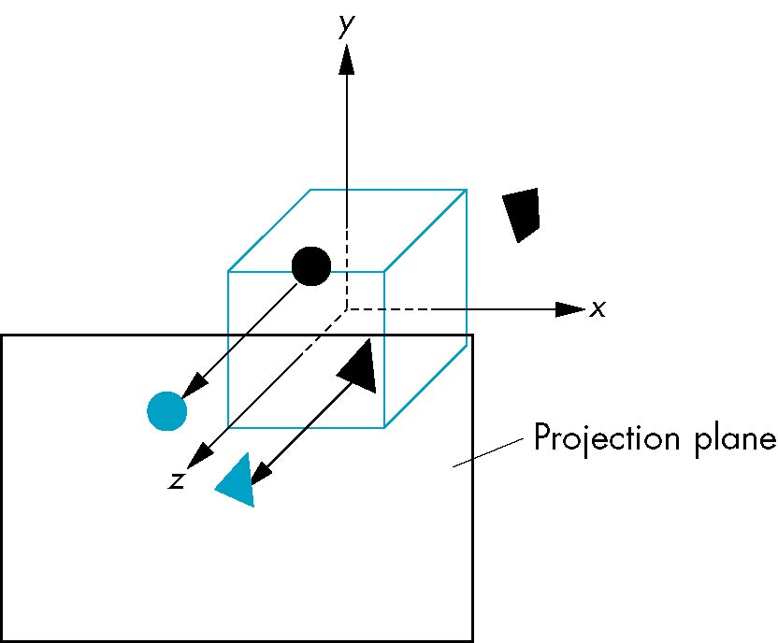
Default Projection
Default projection is orthogonal
clipped out
2
z=0

Slide 6
Moving the Camera Frame
If we want to visualize object with both positive and negative z values we can either
  Move the camera in the positive z direction
    Translate the camera frame
  Move the objects in the negative z direction
    Translate the world frame
Both of these views are equivalent and are determined by the model-view matrix
    Want a translation (glTranslatef(0.0,0.0,-d);)
    d > 0

Slide 7
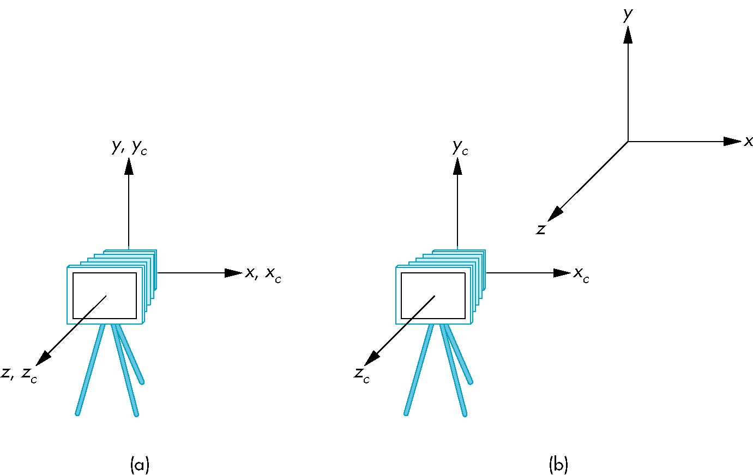
Moving Camera back from Origin
frames after translation by –d
d > 0
default frames

Slide 8
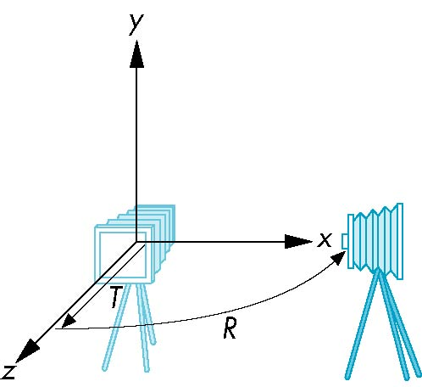
Moving the Camera
We can move the camera to any desired position by a sequence of rotations and translations
Example: side view
  Rotate the camera
  Move it away from origin
  Model-view matrix C = TR

Slide 9
OpenGL code
Remember that last transformation specified is first to be applied
glMatrixMode(GL_MODELVIEW)
glLoadIdentity();
glTranslatef(0.0, 0.0, -d);
glRotatef(90.0, 0.0, 1.0, 0.0);

Slide 10
The LookAt Function
The GLU library contains the function glLookAt to from the required modelview matrix through a simple interface
Note the need for setting an up direction
Still need to initialize
  Can concatenate with modeling transformations
Example: isometric view of cube aligned with axes
glMatrixMode(GL_MODELVIEW):
glLoadIdentity();
gluLookAt(1.0, 1.0, 1.0, 0.0, 0.0, 0.0, 0., 1.0. 0.0);

Slide 11
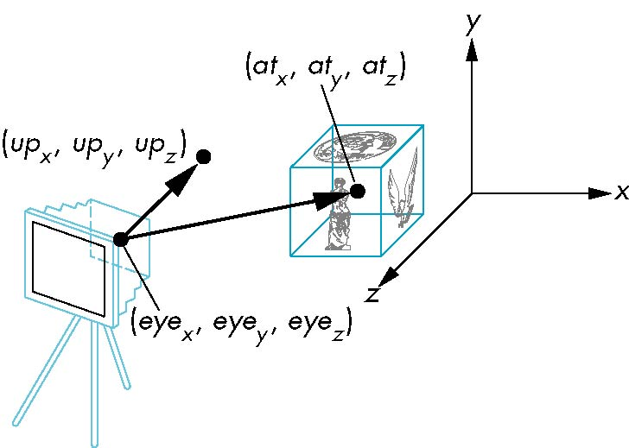
glLookAt
glLookAt(eyex, eyey, eyez, atx, aty, atz, upx, upy, upz)

Slide 12
Other Viewing APIs
The LookAt function is only one possible API for positioning the camera
Others include
  View reference point, view plane normal, view up (PHIGS, GKS-3D)
  Yaw, pitch, roll
  Elevation, azimuth, twist
  Direction angles

Slide 13
Projections and Normalization
The default projection in the eye (camera) frame is orthogonal
For points within the default view volume
Most graphics systems use view normalization
  All other views are converted to the default view by transformations that determine the projection matrix
  Allows use of the same pipeline for all views
x_{p} = x
y_{p} = y
z_{p} = 0

Slide 14
Homogeneous Coordinate Representation
x_{p} = x
y_{p} = y
z_{p} = 0
w_{p} = 1
p_{p} = Mp
M =
In practice, we can let M = I and set
the z term to zero later

Slide 15
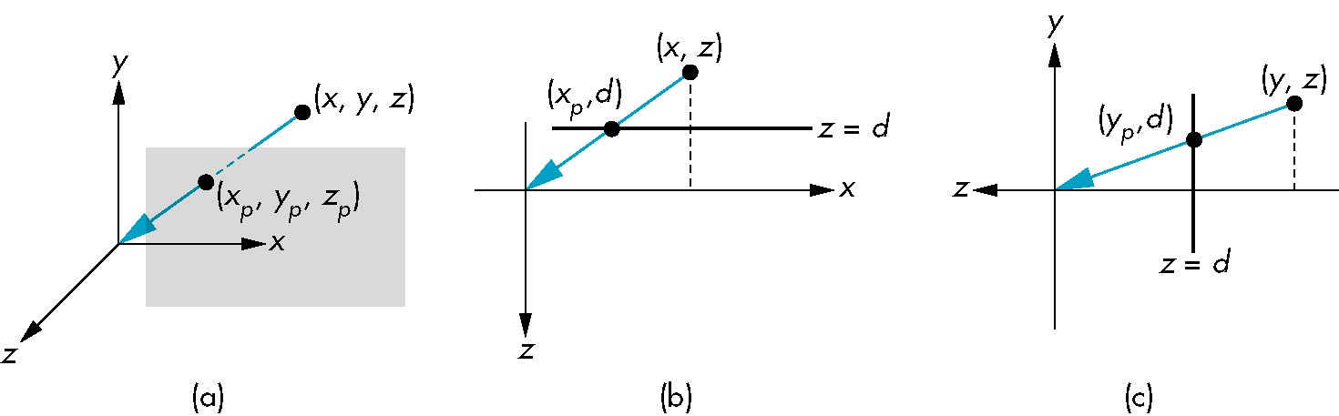
Simple Perspective
Center of projection at the origin
Projection plane z = d, d < 0

Slide 16
Perspective Equations
Consider top and side views
x_{p} =
y_{p} =
z_{p} = d

Slide 17
Homogeneous Coordinate Form
consider q = Mp where
M =
p =
⇒ q =

Slide 18
Perspective Division
However w = z/d, which isn’t necessarily = 1, so we must divide by w to return to homogeneous coordinates
This perspective division yields
the desired perspective equations
We will consider the corresponding clipping volume with the OpenGL functions
x_{p} =
y_{p} =
z_{p} = d

Slide 19
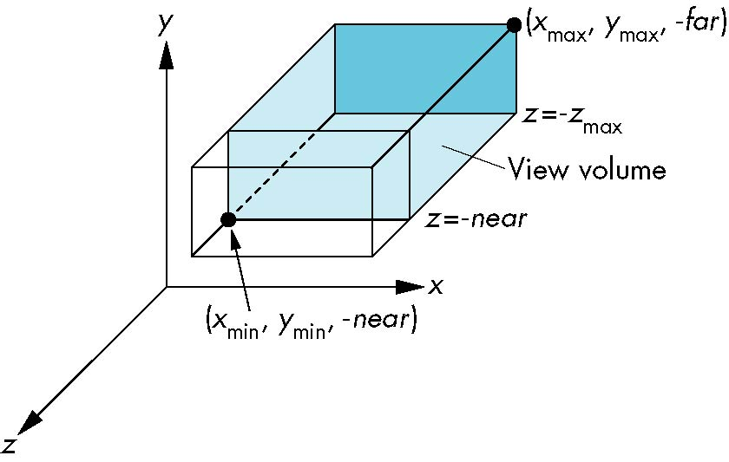
OpenGL Orthogonal Viewing
glOrtho(xmin,xmax,ymin,ymax,near,far)
glOrtho(left,right,bottom,top,near,far)
near and far measured from camera

Slide 20
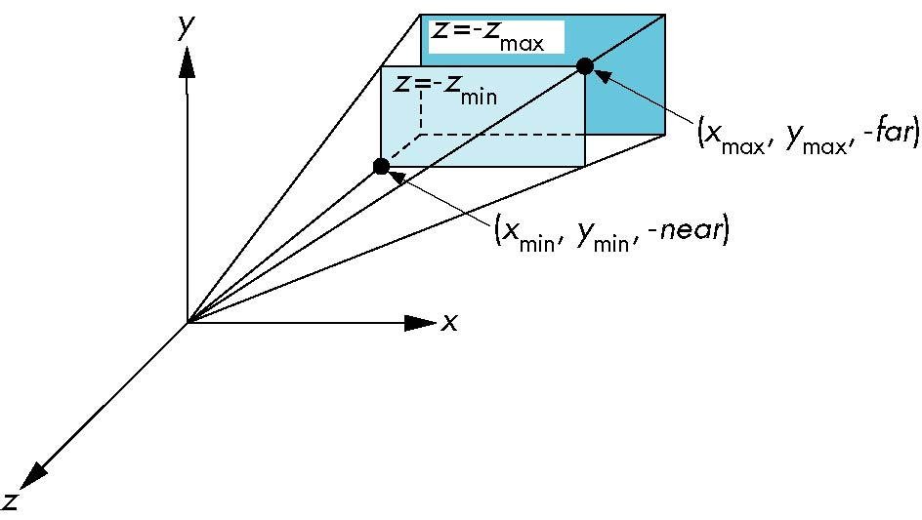
OpenGL Perspective
glFrustum(xmin,xmax,ymin,ymax,near,far)
Fig 5.27

Slide 21
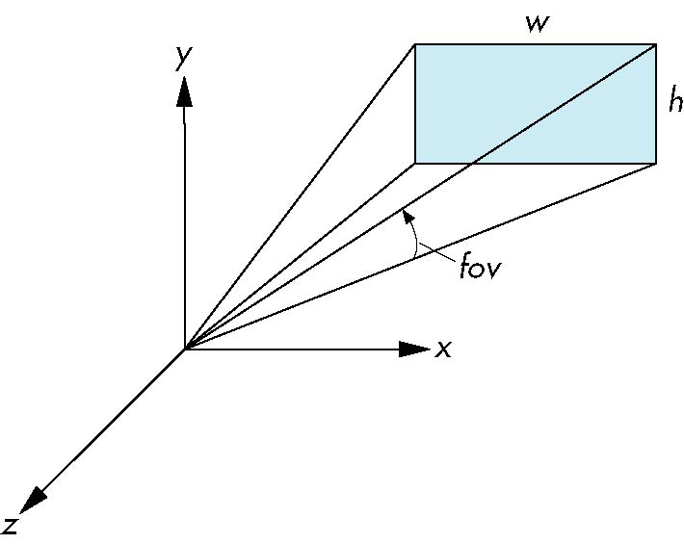
Using Field of View
With glFrustum it is often difficult to get the desired view
gluPerpective(fovy, aspect, near, far) often provides a better interface
front plane
aspect = w/h

Slide 22
Hidden Surface Removal via z-buffer
Calculate distance from each polygon to COP for each pixel.

Slide 23
cubeview.exe
Sample program allows camera to be moved with x,y,z keys.
Camera always points at origin.
Cube is centered at origin.
Mouse buttons rotate the cube (the model) around the primary axes
Cubeview.exe
Cubeview.c

